Slide 1
A Texas Size Opportunity for the College Board
By Christopher Williams
DSI November 20, 2018

Slide 2
Background
Texas is the second largest market of SAT test with 226,374 students taking the SAT in 2018 out of the 341,613 High School Graduates or 66% of 2018 class.
In 2018 Texas represents 10.5% of all 2018 US SAT test takers.
Notes:
Texas https://reports.collegeboard.org/pdf/2017-texas-sat-suite-assessments-annual-report.pdf
California https://reports.collegeboard.org/pdf/2018-california-sat-suite-assessments-annual-report.pdf

Slide 3
Proposal
As of August 2018, Texas education policy makers at Texas Education Agency have proposed a decision to require the SAT or ACT for high school students as part of their Federally Mandated testing.
“In a proposed change to its administrative rules, the TEA said it would use the ACT and SAT — two standardized tests administered for college admissions — to test those students in high school, and that school districts and charter schools should pay for them.” - Texas Tribune
Notes:
Source: https://www.texastribune.org/2018/10/03/standardized-testing-ACT-SAT-pay-Texas/

Slide 4
Proposal continued
“Specifically, the proposed amendment would modify subsection (e) to require school districts to use the SAT or ACT to fulfill federal high school assessment requirements for students who took the State of Texas Assessments of Academic Readiness (STAAR®) Algebra I EOC assessment or both the STAAR® English I and English II EOC assessments prior to high school. “
Texas Education Agency (August 24, 2018)
Notes:
https://tea.texas.gov/About_TEA/Laws_and_Rules/Commissioner_Rules_(TAC)/Proposed/18_08_Proposed_Amendment_to_19_TAC_%C2%A7101_3011/

Slide 5
Problem
In light of the proposal, how can we use the data provided to help the College Board expand the SAT in the Texas market and not lose the foothold it has to the ACT.
The College Board needs to empirically prove the SAT is a better test than the ACT and gain rest of the students.
We must avoid the pitfalls of the inverse relationship between testing participation and mean scores as policy makers often make decisions based on average testing score results.
This potential change to Texas High School educational testing requirements could be good or bad for the College Board and SAT testing participation.
The problem is that the College Board could be on the losing side of this proposal if the Texas Legislature and school administrations deem the ACT to be a better exam for their testing needs. The SAT could lose its share of students it currently test.

Slide 6
Opportunity
If we can prove that mandating the SAT can increase Texas High School students’ college academic readiness, and prove that the SAT is a better assessment of student’s preparation, then we can put ourselves in a position to win the place of being a required test for Texas high schools students.
Join the likes of other states where SAT is required like Colorado and Illinois, represents a market opportunity of about 115,000 additional students or $5,750,000 in addition to the $11.3 million in current revenue and 226k students.

Slide 7
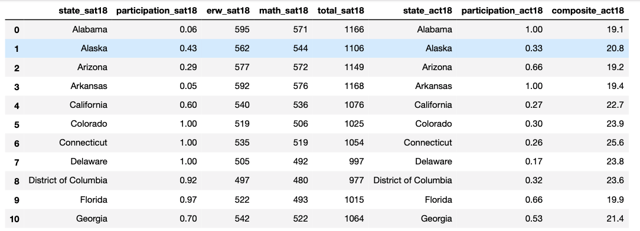
SAT vs. ACT Data Provided
We were provided 2017 to 2018 national SAT & ACT data for all 50 states and DC. We had to clean the data and merge the separate dataframes. For 2017, we were provided for both SAT & ACT the breakdown of each test’s sections. However, here’s an example of 2018 data we were provided with, which included each section of SAT but did not include the breakdown of each part of the ACT :

Slide 8
SAT vs. ACT Participation
From 2017 to 2018 Texas SAT high school student participation increased from 62% to 66%, whereas the median national SAT participation was 52%. Texas Mean SAT Scores increased from 1020 to 1032 from 2017 to 2018.
During the same time, ACT high school student participation stayed flat at 45%, whereas the median national ACT participation was 66%. Also ACT mean score stayed the same at 20.7

Slide 9
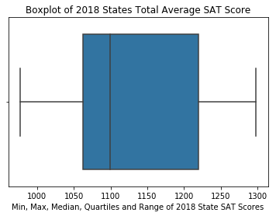
Data on Texas 2018 SAT
Texas SAT mean score of 1032 lag behind national mean of 1068 out of total potential of 1600
Notes:
https://blog.prepscholar.com/act-scores-by-state-averages-highs-and-lows

Slide 10
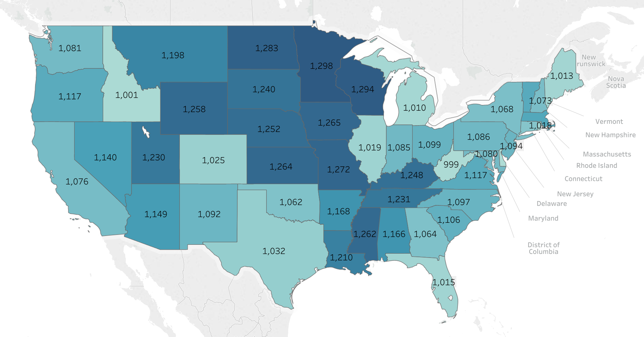
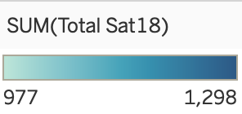
2018 Average SAT Score per State
a

Slide 11
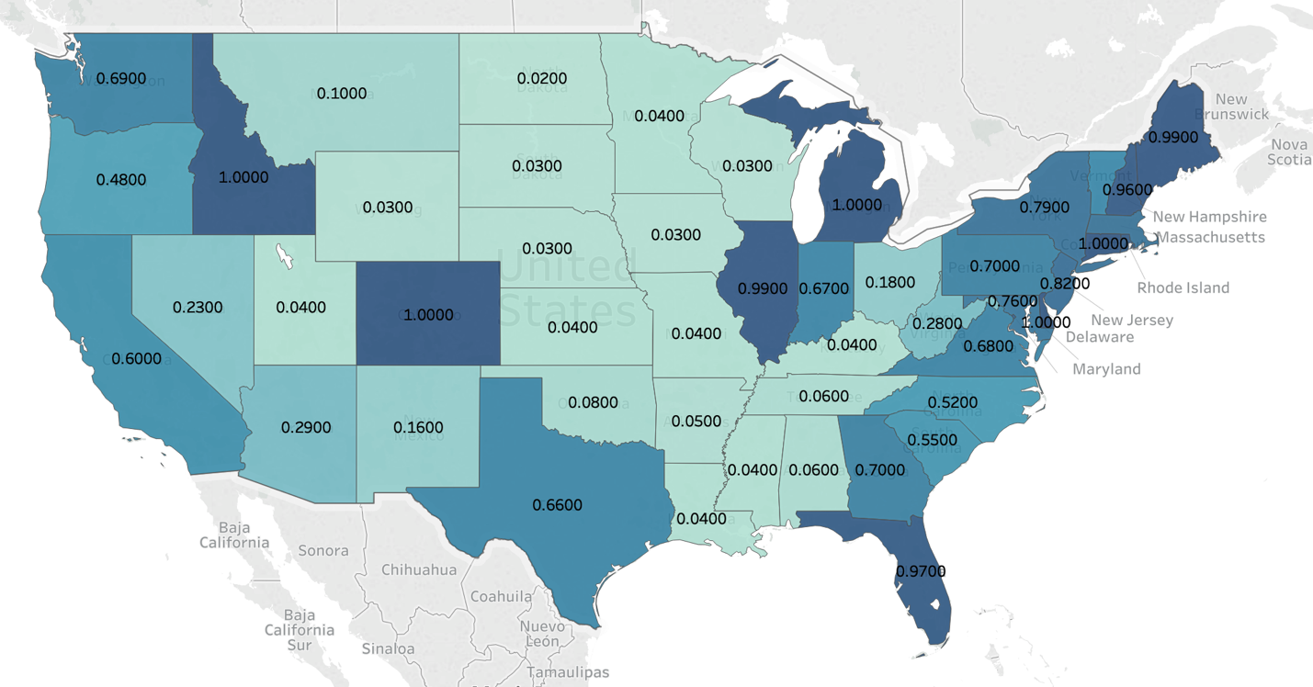
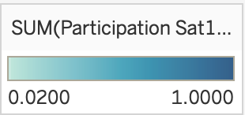
2018 Average SAT Participation per State

Slide 12
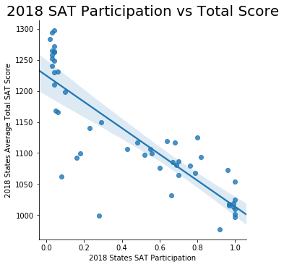
Inverse Relationship in SAT Participation and Score per States
Must demonstrate to Texas administrators that SAT Score averages are inversely related to participation percentage is not a bad thing. Correlation is - 0.85

Slide 13
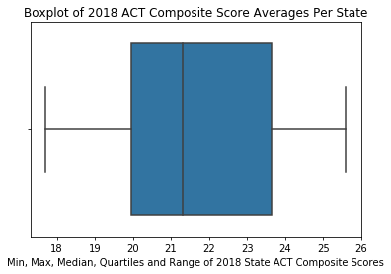
Data on Texas 2018 ACT
Texas ACT mean score of 20.7 also lags at national average of 21.5 out of a total possible of 36

Slide 14
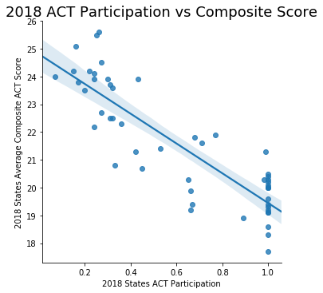
Inverse Relationship in ACT as well
The ACT also has that relationship. Correlation is -0.86

Slide 15
Conclusions
With the limited data we were provided, the data shows that as average participation in states increases, SAT scores fall. If the SAT is mandated in Texas, then we should expect average SAT scores to drop. The same would be the case with the ACT scores.
The College Board must overcome this obstacle with public policy maker’s potentially misunderstood perception of that inverse relationship of participation and scoring averages.
As well, the College Board needs to continue to prove the merit of the SAT as a measure of college preparation for High School Students by providing data, if possible, that empirically proves that students using the SAT as a primary admittance test have better college success due to its rigor, necessary preparation requirements, and mental assessment.
Notes:
State of Texas Assessments of Academic Readiness
https://tea.texas.gov/About_TEA/Laws_and_Rules/Commissioner_Rules_(TAC)/Proposed/18_08_Proposed_Amendment_to_19_TAC_%C2%A7101_3011/

Slide 16
Recommendations
If possible and true, utilize data demonstrating that the SAT is a better assessment of High Schools student’s core math and reading assessments than the STARR exams.
Analyze data on how successful students are during college that use the SAT versus ACT as the entrance exam and thus the barometer for their college preparation.

